Slide 1

NAME : MANMOHAN RAJPAL
SECTION : B
ROLL NUMBER : 37
STUDENT ID: 20011019
SEMESTER – III
Submitted to:
Dr. Rakesh Patra (CC-CSE-B-III-Sem)
Guided by :
Dr. Satvik
Session: 2021-2022

Slide 2
Random Password Generator
Mini Project Report Semester - 3

Slide 3
Objective
With growing technology, everything has relied on data and securing these data is the main concern. Passwords are meant to keep the data safe that we upload on the Internet.
An easy password can be hacked easily and all the personal information can be misused. In order to prevent such things and keep the data safe, it is quite necessary to keep our passwords very strong.
Let’s create a simple application that can generate random password, with the combination of letters, numeric, and special characters. One can mention length of the password based on requirement and can also select the strength of the password.

Slide 4
Overview
In this project, the user has to select the password length and then click on the “Generate Password” button. It will show the generated password below. The user can also choose the strength of the generated password:
“Low” is a combination of random lowercase letters and digits.
“Medium” is a combination of random lowercase and uppercase letters and digits.
“Strong” is a combination of random lowercase and uppercase letters, punctuation symbols and digits.
and if the user clicks on the “Copy to Clipboard” button, then it will copy the password automatically.

Slide 5
Challenges faced
At the beginning of the project the main challenge I faced was of how the characters/symbols/numbers would be randomly picked and then stored so as to generate a random password.
The second challenge I faced was in the implementation phase of the first challenge.

Slide 6
OVERCOMING THE CHALLENGES
The mentors that were assigned to me for the project were very helpful throughout the process of making the project.
The mentors helped in every possible to overcome the challenges being faced and gave me solution to every problem I was facing while the making of the project.

Slide 7
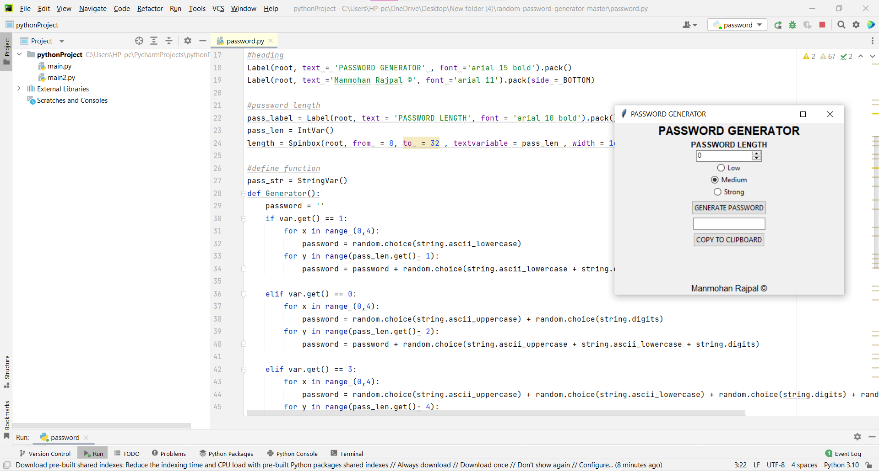
Source Code
IDE Software used: VS Code

Slide 8
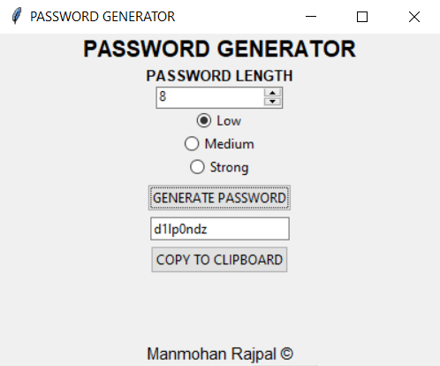
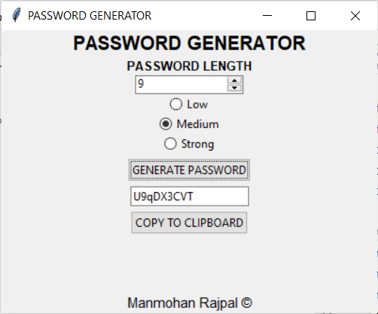
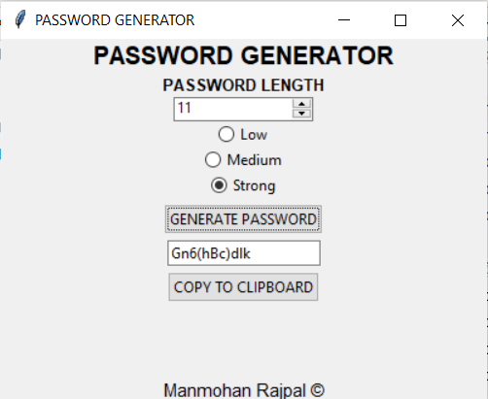
SNAPSHOTS
LOW
MEDIUM
STRONG

Slide 9
Thank You !

